Slide 1

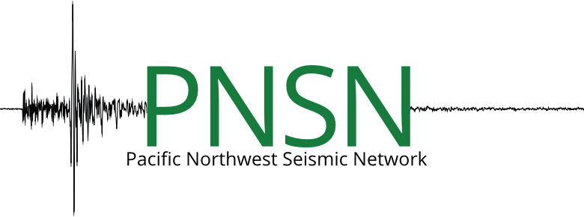

Ensemble Earthquake Early Warning System (E3WS) Performance Testing by PNSN-Curated Data
Nate Stevens, Benz Poobua, Jake Ward
University of Washington, PNSN
Notes:
Earthquake early warning now available to Oregon public. Earthquake early warning now available to Oregon public | Around the O. (2021a, March 10). https://around.uoregon.edu/content/earthquake-early-warning-now-available-oregon-public

Slide 2
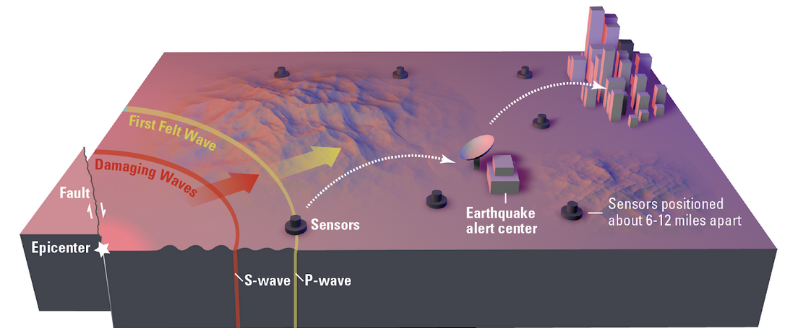
Introduction
Motivation
Limitations
Nearly 1 million deaths due to earthquakes since 1990 Earthquake Early Warning System used to mitigate human losses
Most EEWS are based on multi-station data (more information and trade-off delays)
Most single-sensor-based algorithms only contain some components of an EEWS (detection, picking, magnitude, or location)
1
(“How it works”, n.d.)
Notes:
Earthquake Warning California. (n.d.). How it works. How It Works | California Earthquake Early Warning. https://earthquake.ca.gov/how-it-works/
In an earthquake, a rupturing fault sends out two different types of waves. The fast-moving P-wave is first to arrive, but the damage is caused by the slower S-waves and surface waves.
Sensors detect the P-wave and immediately transmit data to an earthquake alert center where the location and size of the quake are determined and updated as more data becomes available.
A message from the alert center is immediately transmitted to users.
- The single-station based EEWS: faster approach
- Trade-off between the earliest alert time and the accuracy of the estimates (Meier, 2017)

Slide 3
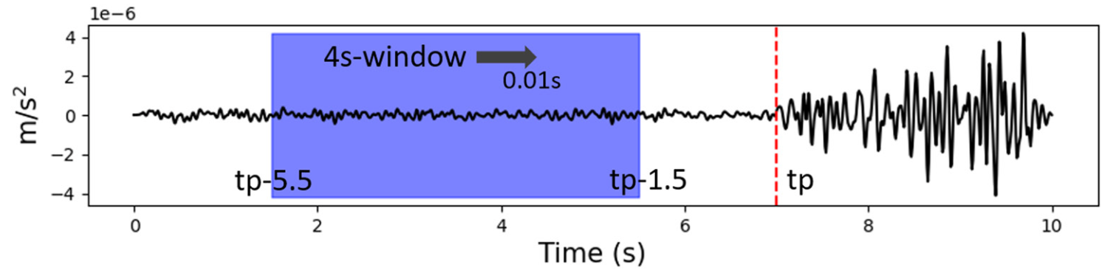
Introduction
Inspiring Literatures
Lara et al. (2023)
E3WS: the first EEWS in which all components (detection, picking, and source parameters) are based on AI
3 seconds of recorded by a single 3-component instrument
For near seismic sources (less than 200 km)
Detector, P-phase picker,
Source Characterization (regression models): magnitude, epicentral distance, back azimuth, and depth of the source
2
Notes:
Lara, P., Bletery, Q., Ampuero, J. P., Inza, A., & Tavera, H. (2023). Earthquake Early Warning starting from 3 s of records on a single station with machine learning. Journal of Geophysical Research: Solid Earth, 128(11), e2023JB026575.
- Look at page 3; last3 lines describing a feature vector

Slide 4
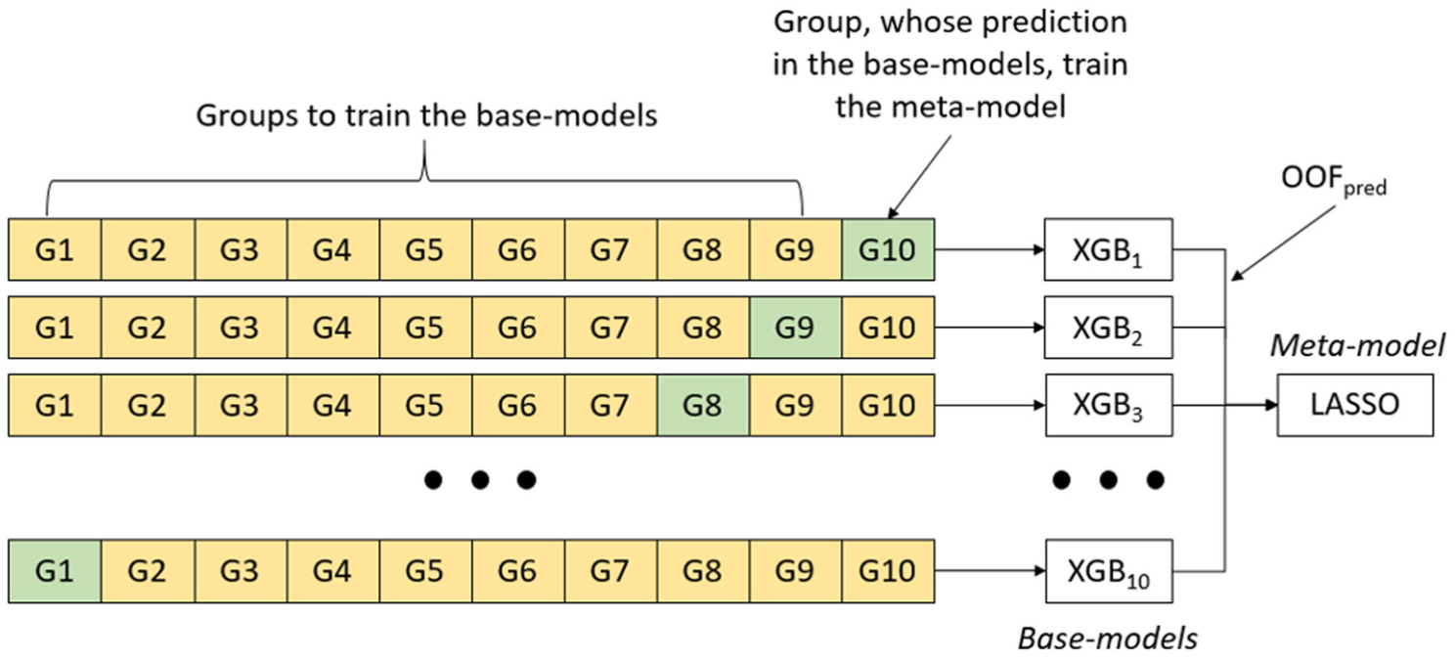
Introduction
Project Question
Is the performance of our model using PNSN-curated data better or worse, relative to the work of Lara et al. (2023)?
How can we improve the model’s performance?
what are the contributing factors causing the model uncertainty?
ML Approaches
Stacking algorithm
K-fold validation (K = 10)*
XGBoost*
LASSO
(Lara et al., 2023)
3
Notes:
- We focus on magnitude, so LASSO and Stacking algorithm are not performed here.

Slide 5
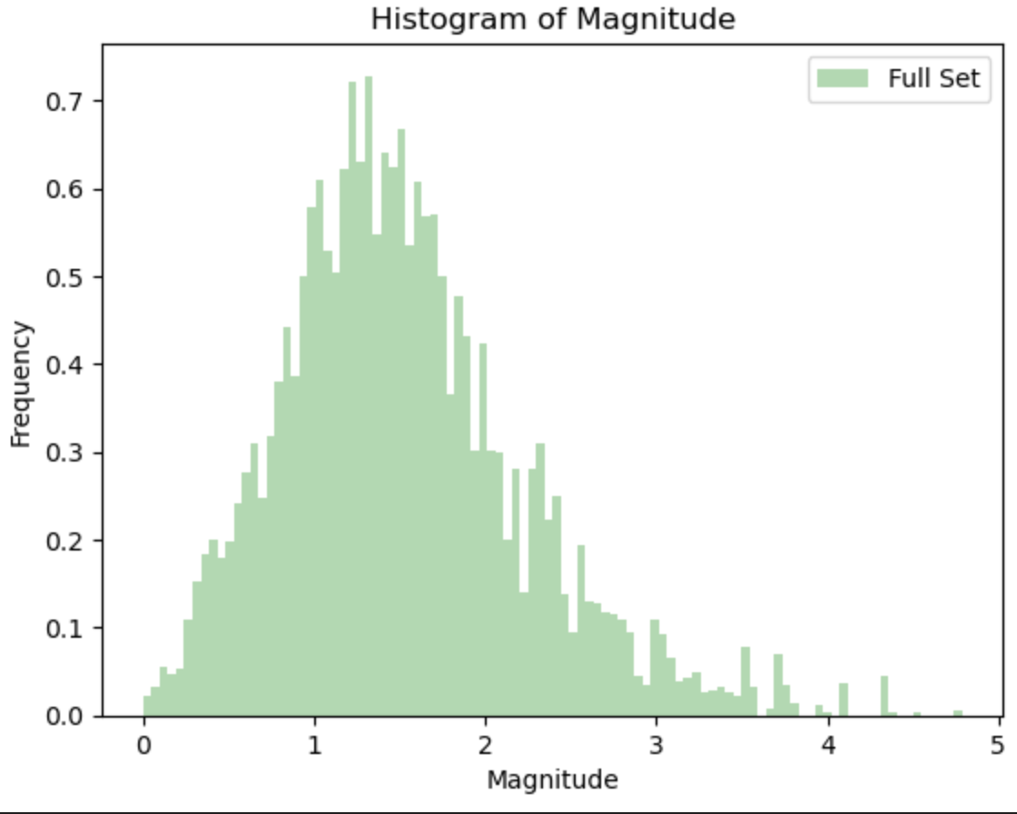
Methodology
Part 1: Data Processing (Data Characterizing/Curating)
From https://pnsn.org
latitude range: 42 - 49 °N
longitude range 122 - 125.5 °W
magnitude range: 0 - 8
Exclude Mount St. Helens events: True
Date Range: 2015-01-01 to 2023-11-17
X = feature vectors numpy array (65821,140)
Dimensionality Reduction
y = magnitude numpy array (65821,1)
Note We focus on magnitude for this project
4

Slide 6
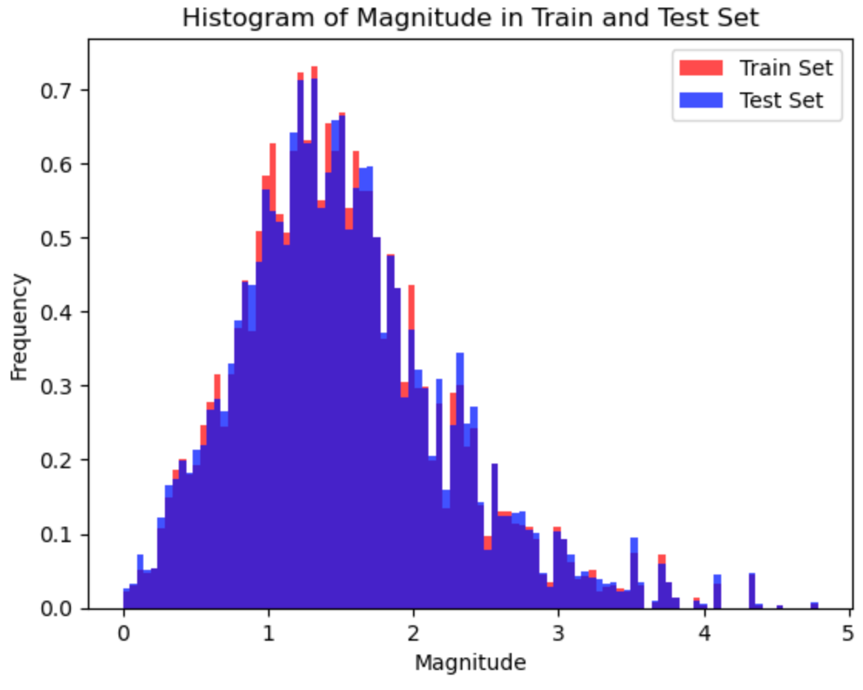
Methodology
Part 1: Data Processing (Data Splitting)
80% train + 20% test
X_train.shape = (52656, 140)
X_test.shape = (13165, 140)
y_train.shape = (52656, 1)
y_test.shape = (13165, 1)
5

Slide 7
Methodology
Part 2: ML Approach Workflow (not finished)
1. Type of data
Feature vectors (f000 - f139) as input to XGBoost
Numpy array (1,140)
A feature vector formed by concatenating 140 attributes extracted from the waveforms, their spectrum and their cepstrum.
All components of the EEWS (detection, P-phase picking, and source characterization) are based on the same definition of attributes, arranged in a feature vector of length 140, avoiding the use of other algorithms that can increase the processing latency.
6
Notes:
- Feature vectors discussion here (as input fed to XGBoost)
- Note that we skipped the detection and P-wave picking for the simplicity of the workflow

Slide 8
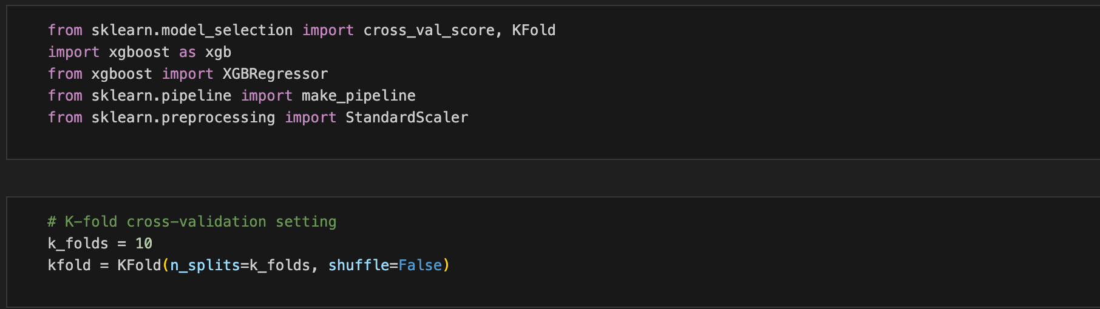
Methodology
Part 2: ML Approach Workflow
2. K-Fold Cross Validation
6

Slide 9
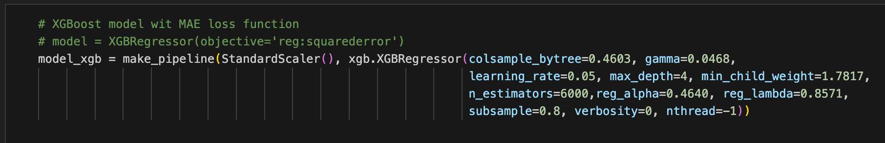
Methodology
Part 2: ML Approach Workflow
3. Extreme Gradient Boosting (XGBoost)
6
Notes:
- hyperparameters from Lara et al. (2023):
Depth = 4
Number of trees = 6000
Subset = 80%
Learning Rate = 0.1

Slide 10
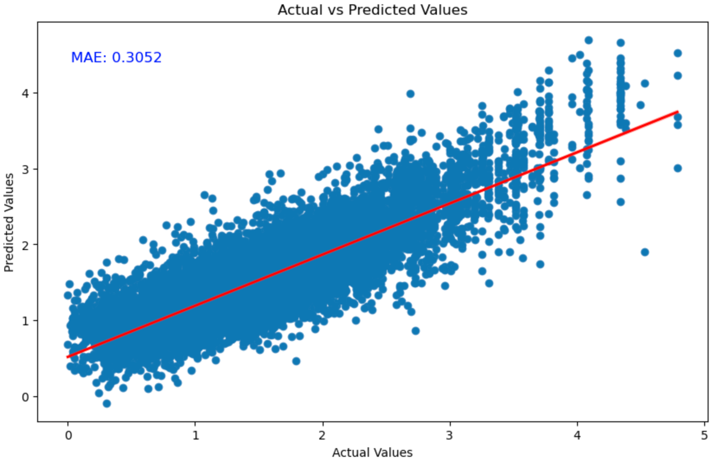
Model Results
MAE for train set = 0.28282909989356997
MAE for test set = 0.3052198588848114
7

Slide 11
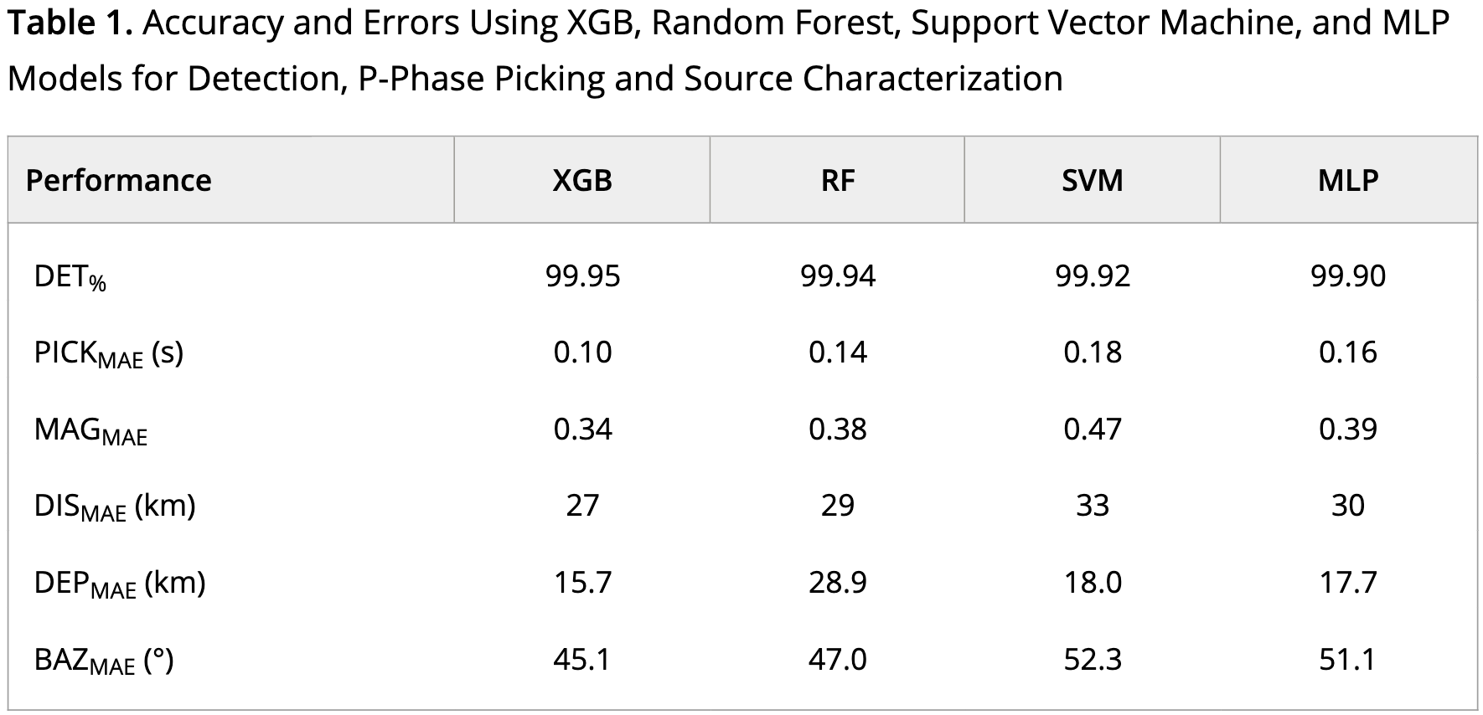
Discussion
Lara et al. (2023)
Mean Absolute Error and R2 results using 3–46 s of P-wave.
How can we improve it?
Hyperparameter tuning
Ensemble methods
Re-curated Dataset
6
Notes:
- ensemble with different dataset
- or transfer learning

Slide 12
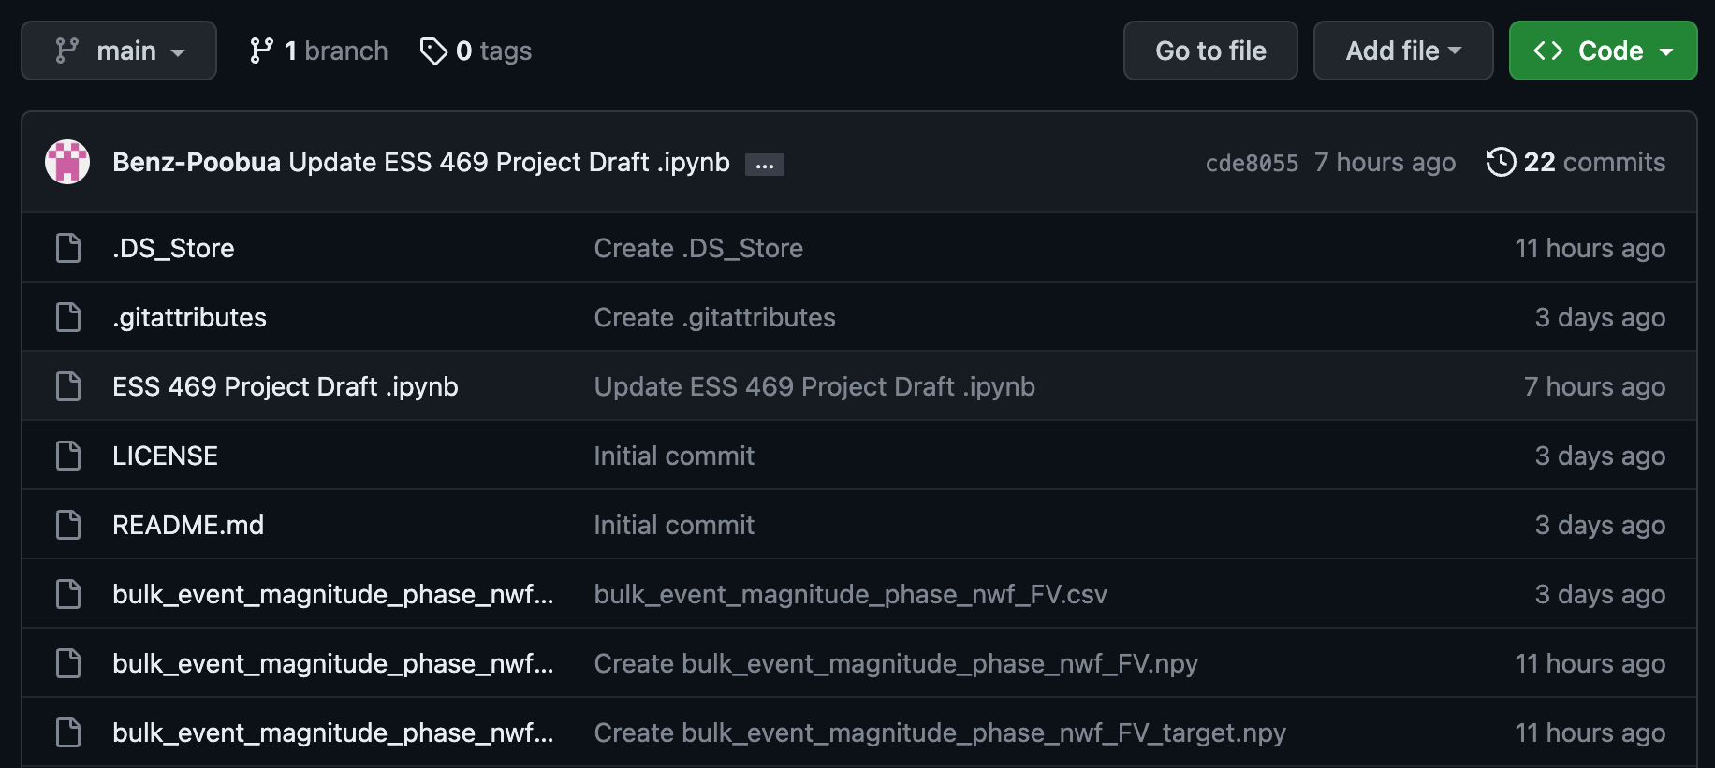
Reproducibility
Script and Datasets provided in Github
https://github.com/UW-ESS-DS/mlgeo-2023-PNSN-E3WS/tree/feature-stevens-examples
https://github.com/Benz-Poobua/ESS-469-Project
script
datasets
8

Slide 13
References
Earthquake Warning California. (n.d.). How it works. How It Works | California Earthquake Early Warning. https://earthquake.ca.gov/how-it-works/
Lara, P., Bletery, Q., Ampuero, J. P., Inza, A., & Tavera, H. (2023). Earthquake Early Warning starting from 3 s of records on a single station with machine learning. Journal of Geophysical Research: Solid Earth, 128(11), e2023JB026575.
9

